Slide 1
Dinghy
Mattias, Niklas, David, Fredrik, Jesper, Alexander, Björn

Slide 2
Requirements
(1) Direction, bearing
(1) Differential pressure across centreboard (rudder)
(1) Log/statistic
(2) Speed Over Ground
(2) Angular Velocities
(2) Position (within 1 inch)
(3) Feedback to skipper (expand)
Start line
Route
Center board pos
Sail pos
(4) Speed In Water
(4) Inclinations
(4) Wind Sensor

Slide 3
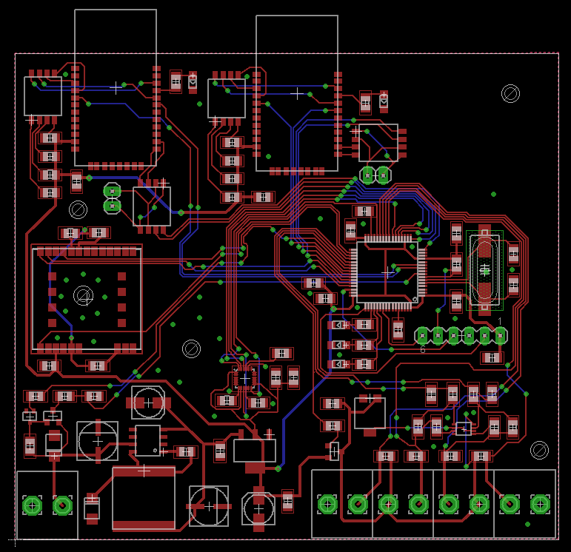
Mainboard prototype 2

Slide 4
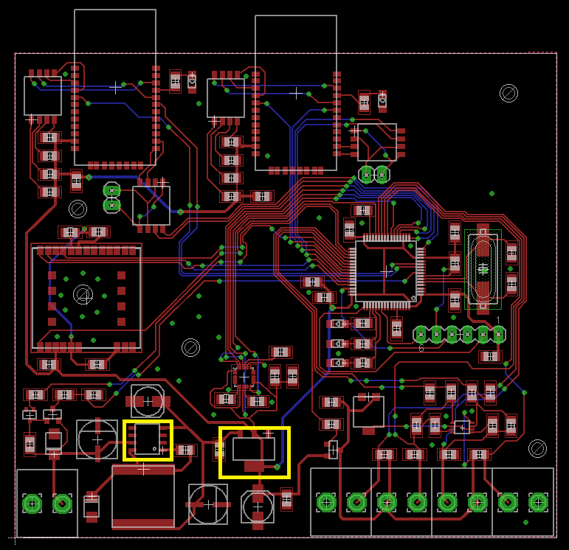
Mainboard prototype 2

Slide 5
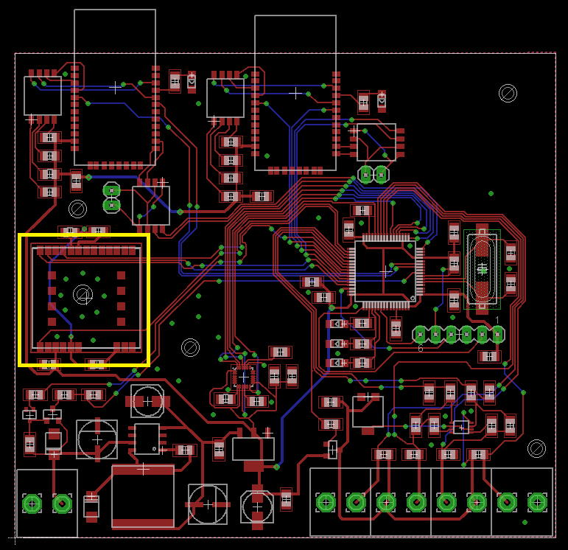
Mainboard prototype 2

Slide 6
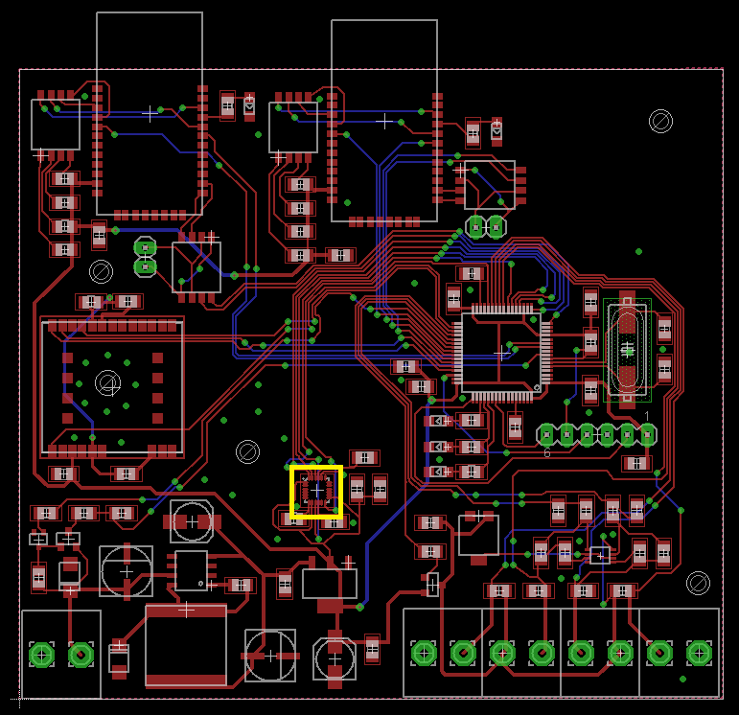
Mainboard prototype 2

Slide 7
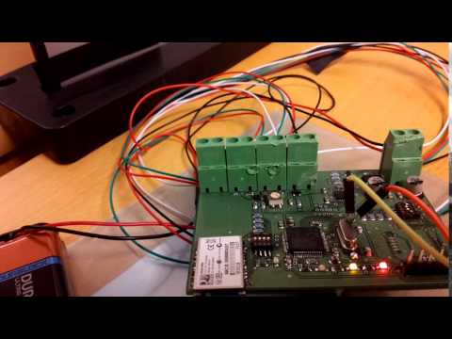

Slide 8
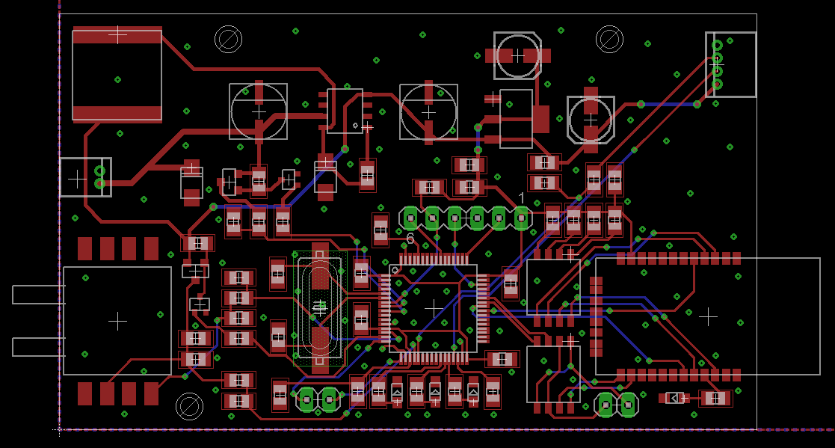
Centerboard prototype 2

Slide 9
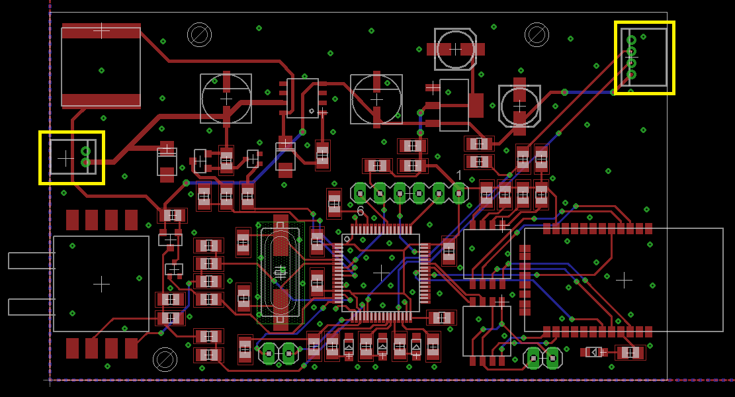
Centerboard prototype 2

Slide 10
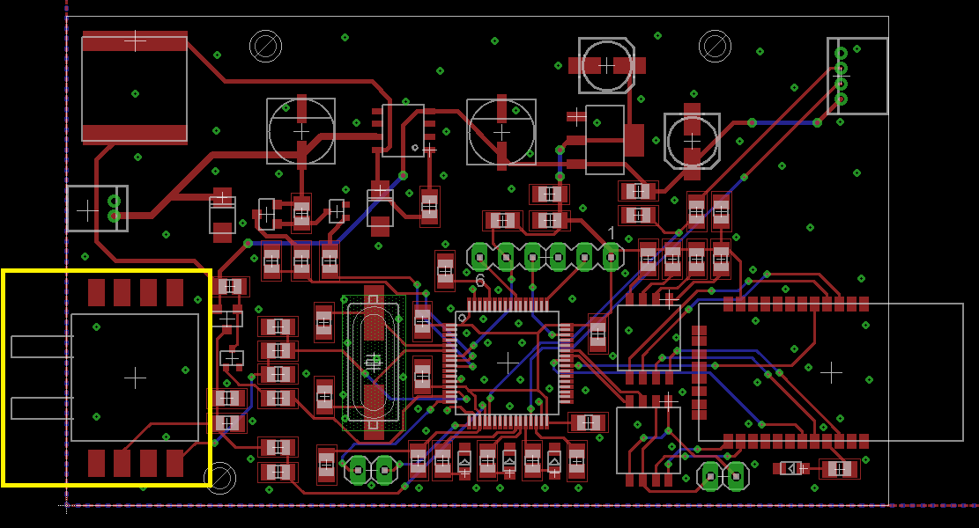
Centerboard prototype 2

Slide 11
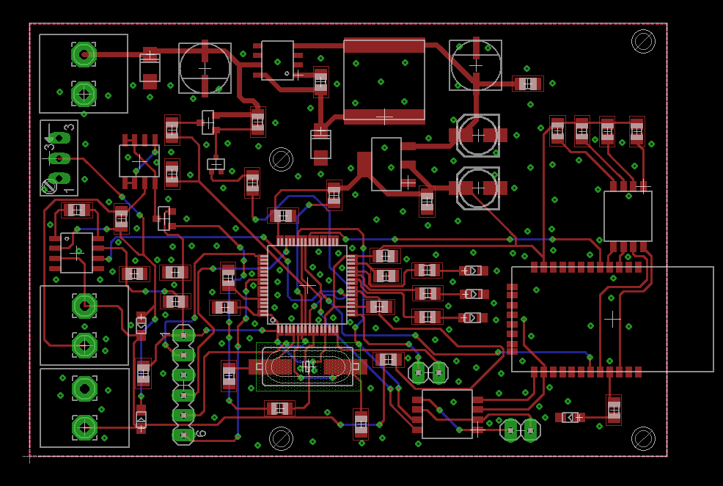
Rudderboard prototype 2

Slide 12
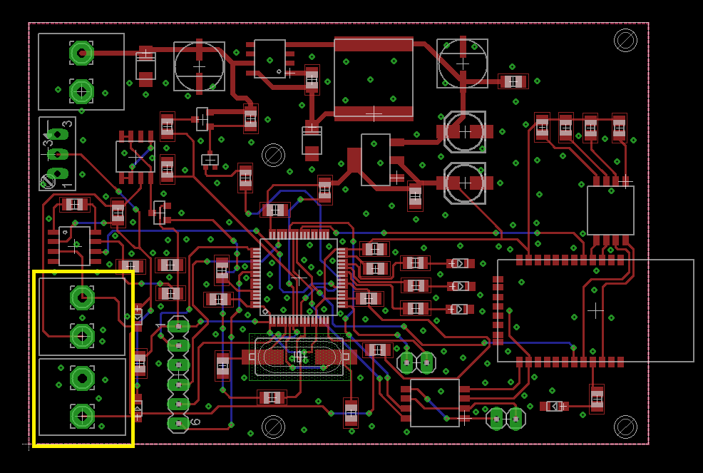
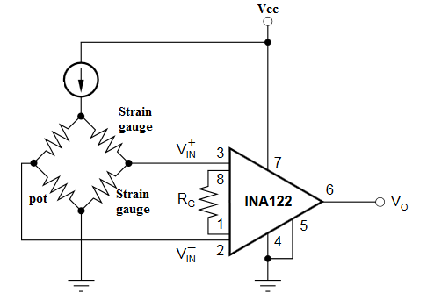
Rudderboard prototype 2

Slide 13
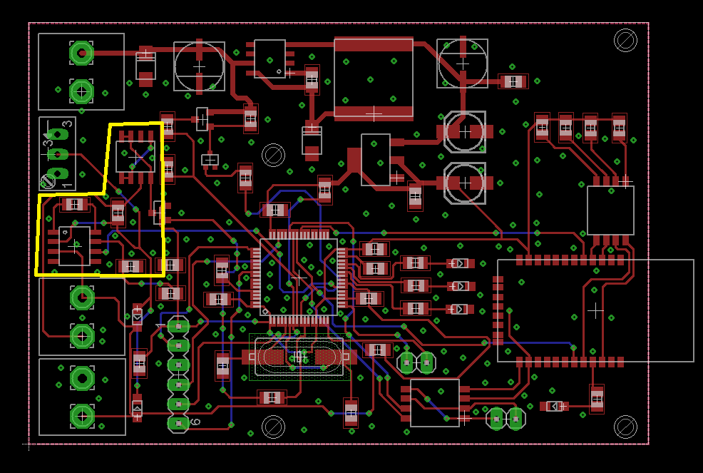
Rudderboard prototype 2

Slide 14
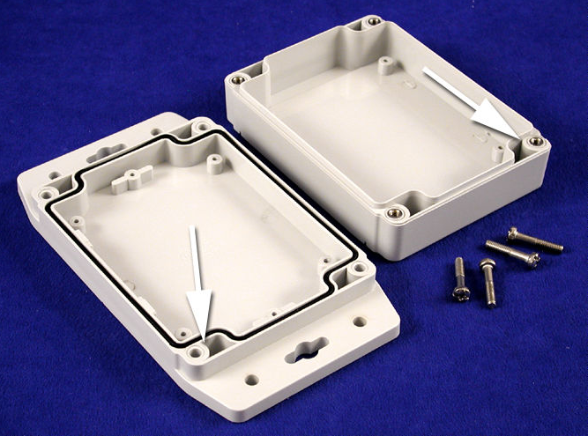
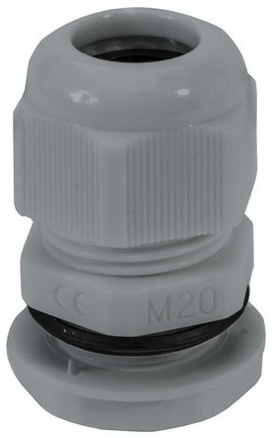
Waterproof box and connectors for main & rudder
IP67
Dust tight and submersion up to 1 m
120 x 120 mm
Cable gland IP68
Tight seal

Slide 15
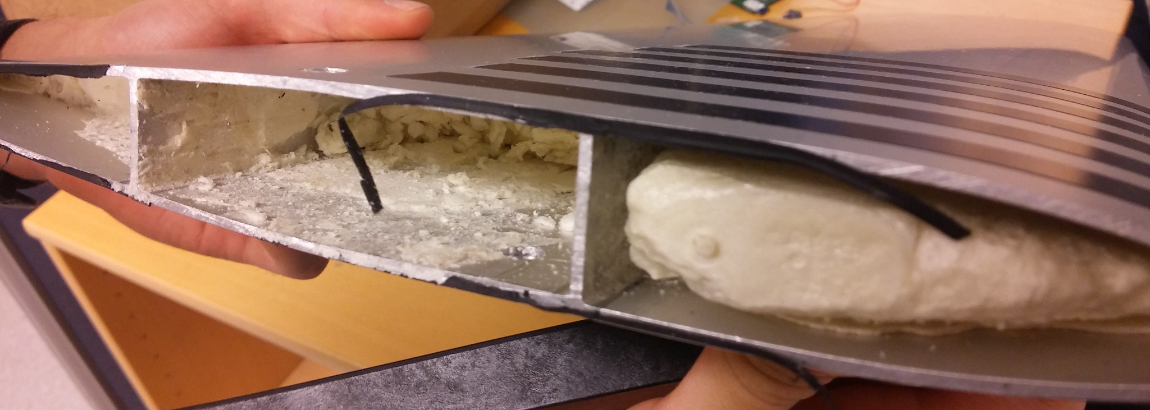
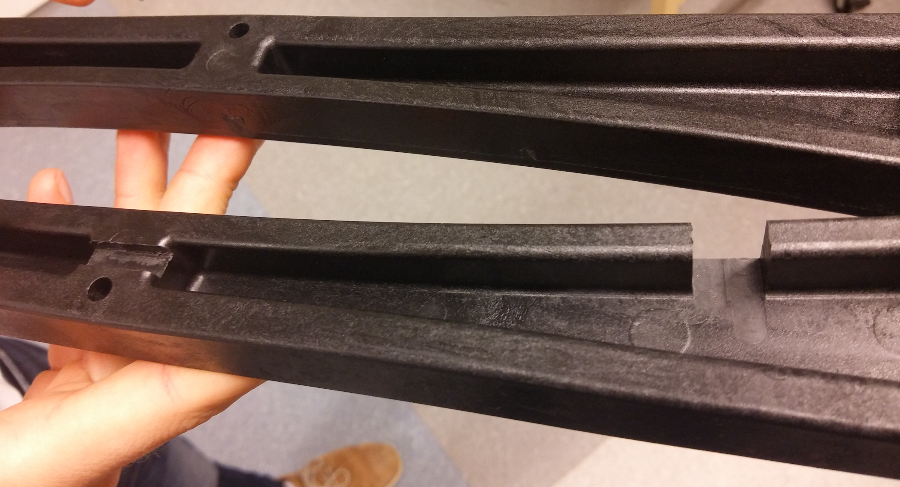
Modification so far

Slide 16
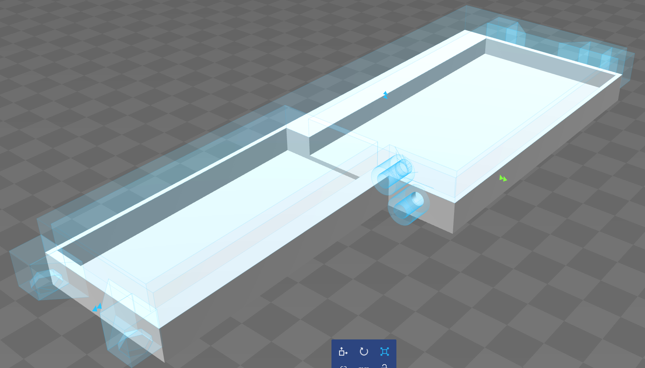
Waterproof box for centerboard

Slide 17
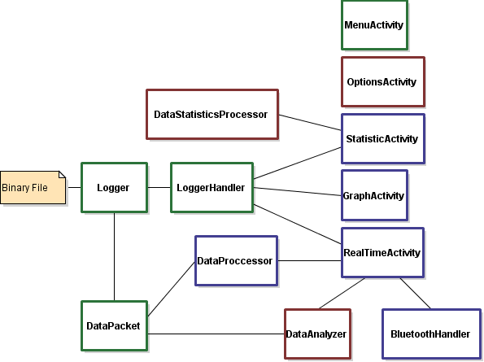
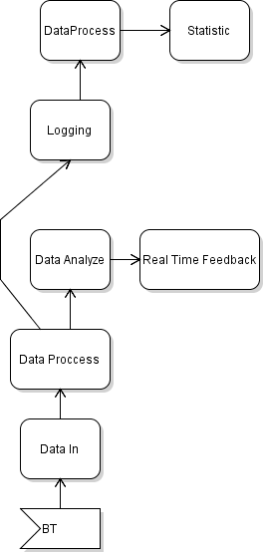
Application
Notes:
BluetoothHandler klar för envägs kommunikation.
DataProcessor strukturellt klar, men behöver skrivas om för att anpassas efter hur våra slutgiltiga datapacket ska se ut.
RealTimeActivity

Slide 18
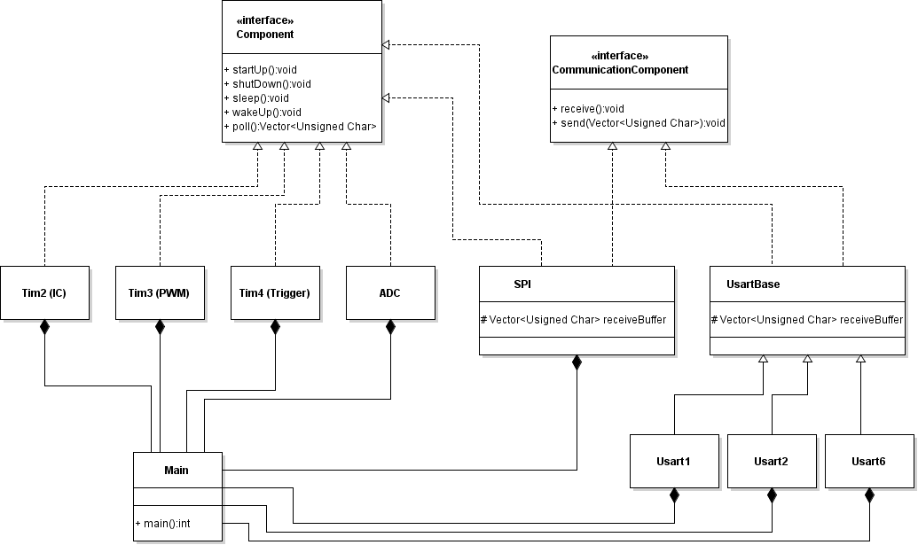
Software - embedded

